Slide 1
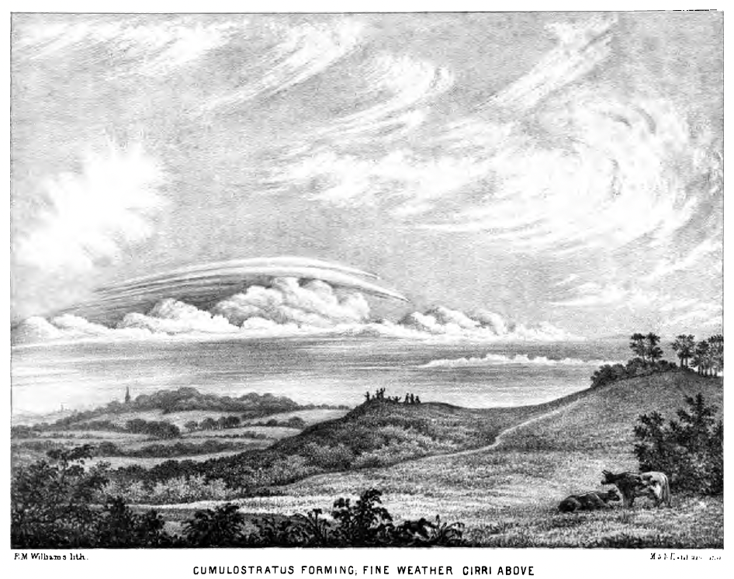
Date: ______________
Weather
Journal
If, as wavists, we believe that change is not determinate, and if we can record the present in enough detail, within a series of closed temporal frames, then kinds of change will perceptibly emerge from the detail of sensing.
—The Perfume Recordist, “Notes on Perfume”
Notes:
8|1

Slide 2
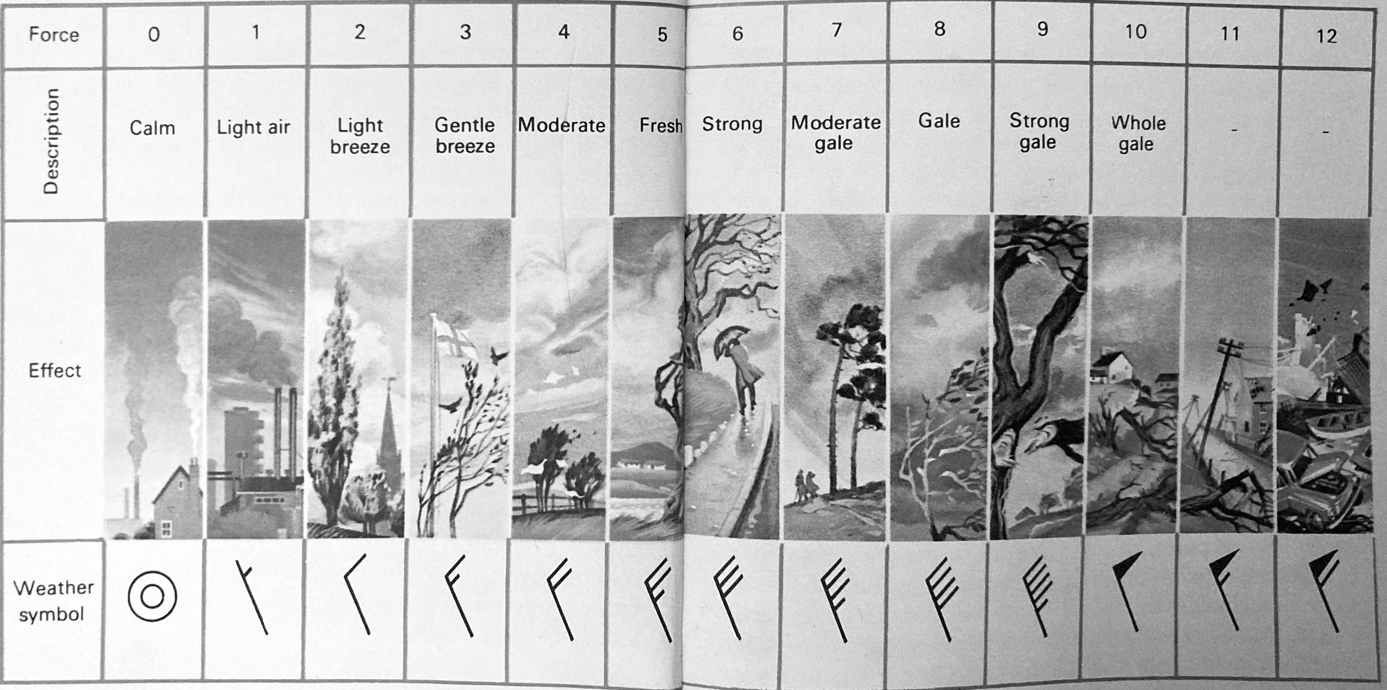
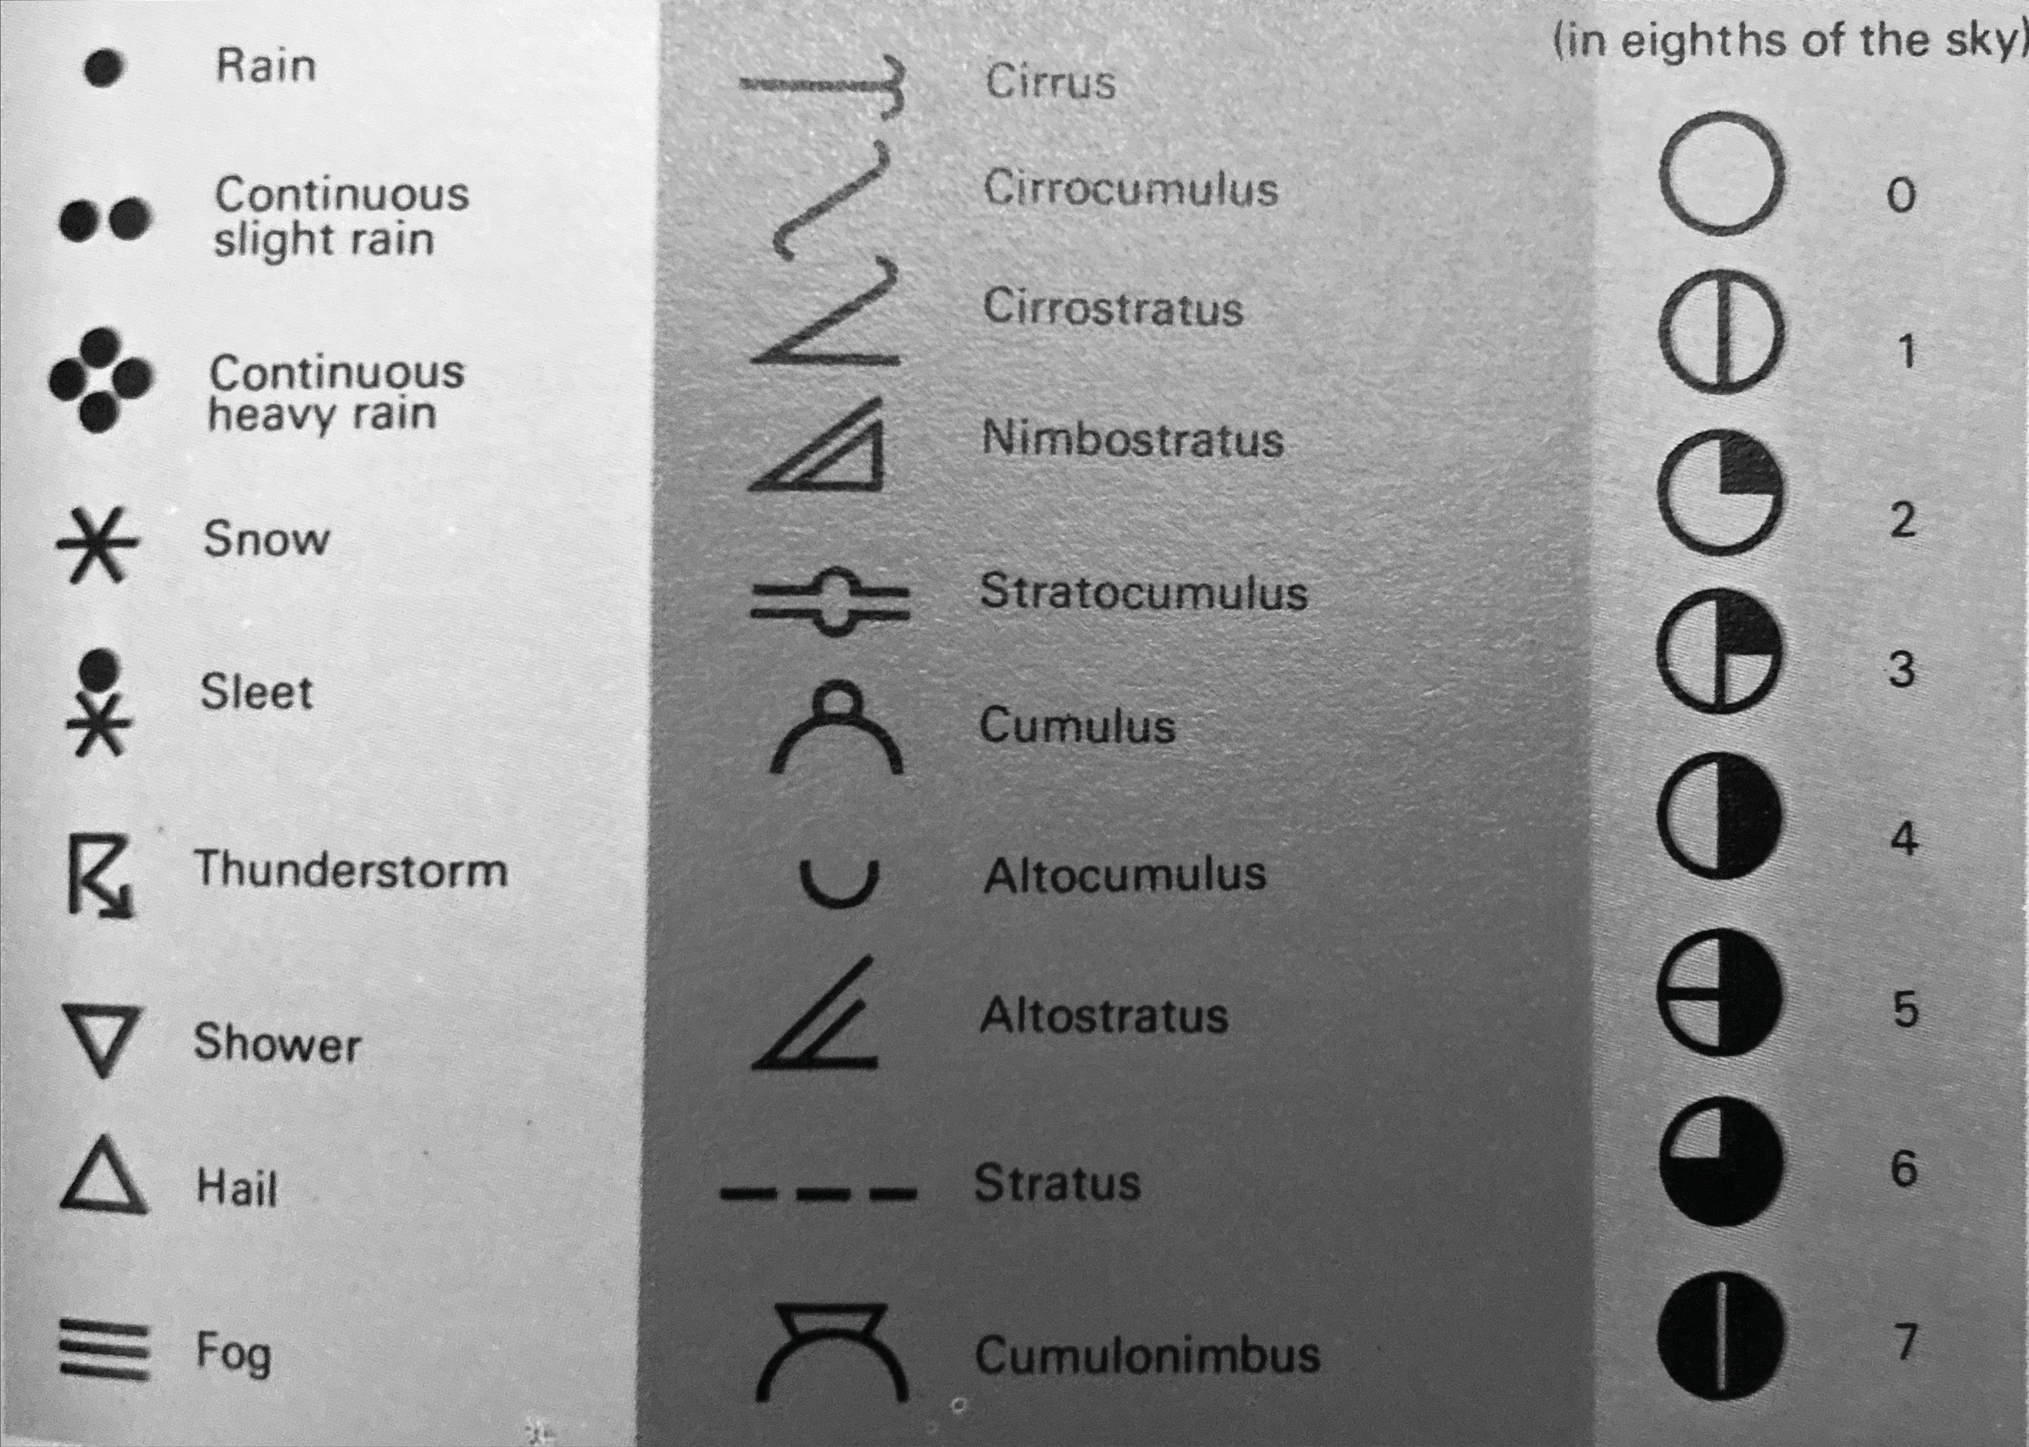
The sky is
(circle all that apply)
Potentially helpful notation
windswept
near
bright
blue
cloudy
starry
clear
vast
gloomy
grey
Forsdyke and McBridge (1970)
indeterminate
indigo
hidden
deep
Draw your
view of
the sky
Forsdyke and McBridge (1970)
This journal was written and designed by Elizabeth Case in 2022, inspired and informed by:
Smailbegović A. (2015). “Cloud Writing: Describing Soft Architectures of Change in the Anthropocene.” Art in the Anthropocene, pp 93-107. Open Humanities Press.
Forsdyke AG and McBridge A. (1970). “Weather and Weather Forecasting.” Bantam Books, New York.
Nelson M. (2009). “Bluets.” Wave Books, Seattle.
Dillard A. (1974). “Pilgrim at Tinker Creek.” Harper & Row , New York.
Odell J. (2019). ”How to Do Nothing.” Melville House, New York.
Notes:
2|7

Slide 3
Observe the weather using 3 words, once an hour for a day
The clouds are
(circle all that apply)
stormy
parallel
low
0800: ______________________________
fibrous
diverging
0900: ______________________________
small
high
heaping
1000: ______________________________
distinct
sheet-like
wispy
1100: ______________________________
undulated
dark
enormous
1200: ______________________________
light
1300: ______________________________
1400: ______________________________
1500: ______________________________
1600: ______________________________
1700: ______________________________
1800: ______________________________
1900: ______________________________
Notes:
6|3

Slide 4

(℉): _______ (feels like to you): _______
Clear
What thrives at this temperature?
Rain
Where does your water come from?
Snow
TEMPERATURE
PRECIPTATION
Hail
Sleet
______
Air Quality: ______________ ppm
N
Is it easy to breathe? yes/no/____
Surroundings: urban suburban rural
WIND
E
W
Climate Zone: __________
LOCALITY
Nearest Plant: __________
Draw the direction & magnitude of the wind
Nearest Animal: __________
S
Notes:
4|5

